Slide 1

Energy Storage Systems
Dr. Chetan Khadse

Slide 2
Lecture 1
Different types energy storage
Basic requirement of EV & HEVs
Basics about energy storage
Energy source used for EV’s & HEV’s

Slide 3
Different types energy storage
Compressed Air Storage
Pumped-Storage Hydroelectricity
Advanced Rail Energy Storage
Flywheel Energy Storage
Battery Storage (used in EV/HEV applications)
Liquid Air Energy Storage
Pumped Heat Electrical Storage
Redox Flow Batteries
Superconducting Magnetic Energy Storage
Methane

Slide 4
EV/HEV Performance Requirements in terms of battery
Hybrid vehicles
High power density
High power delivery for acceleration
Adequate energy density
Wide ambient temperature range
Electric vehicles
High energy density
Fast, reliable charging

Slide 5
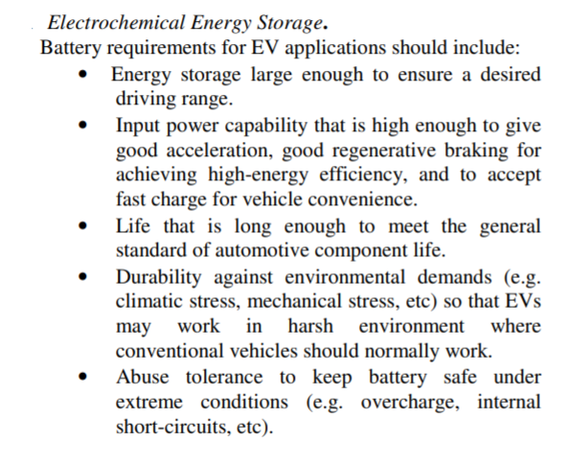

Slide 6
What is battery?
Battery is a type of Energy storage system, which converts chemical energy into electrical energy.
Battery is made up of 2 or more cells , connected in such a way to produce the required amount of power/energy.
For EV/HEV its essential to know as fundamental preparation for knowing how to use cell/battery optimally in an application.

Slide 7
cell
Cells are the smallest individual electrochemical unit, and deliver a voltage that depends on the cell chemistry.
There are primary (single use) and secondary (rechargeable) cells.
A cell is different from a battery

Slide 8
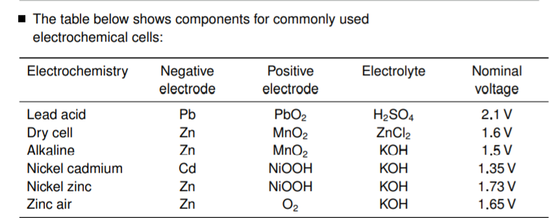
Some example electrochemical cells

Slide 9
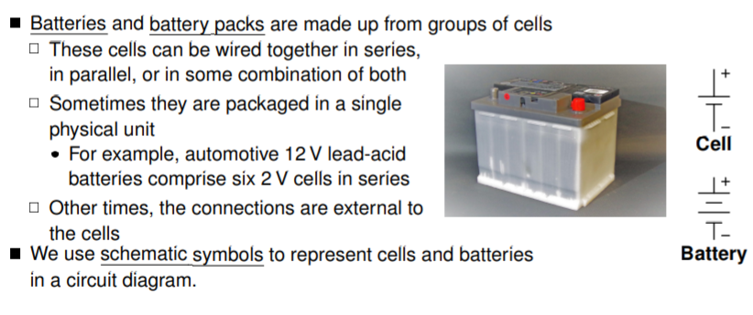
batteries

Slide 10
Energy Storage(Batteries)
A battery consists of two or more electric cells joined together.
The cells convert chemical energy to electrical energy.
The cells consist of positive and negative electrodes joined by an electrolyte.
It is the chemical reaction between the electrodes and the electrolyte which generates DC electricity.
In the case of secondary or rechargeable batteries, the chemical reaction can be reversed by reversing the current and the battery returned to a charged state
The ‘lead acid’ battery is the most well known rechargeable type
The first electric vehicle using rechargeable batteries preceded the invention of the rechargeable lead acid by quarter of a century
There are a very large number of materials and electrolytes that can be combined to form a battery. However, only a relatively small number of combinations have been developed as commercial rechargeable electric batteries suitable for use in vehicles.

Slide 11
Batteries suitable for use in vehicles (Rechargeable)
Lead acid batteries
Lithium ion batteries
Metal air batteries
Nickel iron
Nickel cadmium
Nickel metal hydride
Sodium sulphur and sodium metal chloride.

Slide 12
Overview of Batteries
From the electric vehicle designer’s point of view the battery can be treated as a ‘black box’ which has a range of performance criteria. These criteria will include:
specific energy
energy density
specific power
typical voltages
amp hour efficiency
energy efficiency
commercial availability
cost
operating temperatures
self-discharge rates
number of life cycles
recharge rates

Slide 13
Overview of batteries(designer point of view for EV/HEV Applications)
The designer also needs to understand how energy availability varies with regard to:
ambient temperature
charge and discharge rates
battery geometry
optimum temperature
charging methods
cooling needs.
However, at least a basic understanding of the battery chemistry is very important, otherwise the performance and maintenance requirements of the different types, and most of the disappointments connected with battery use, such as their limited life, self discharge, reduced efficiency at higher currents.

